Slide 1
Test SET optimization
Amir Avitan Stav Sapir

Slide 2
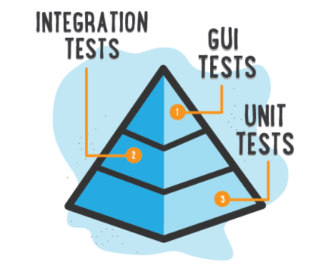


Motivation
Lots of code…
Need to test…
Many tests…Which should I choose?

Slide 3
Input
Software components (classes) with probability for having bug(failure).
Test pass trough 1…n software components (classes).
Each test has its joint probability for having bug(failure).
Each test has its joint probability for pass(success).
Real outcome of tests trace(0 –fail 1- pass).

Slide 4
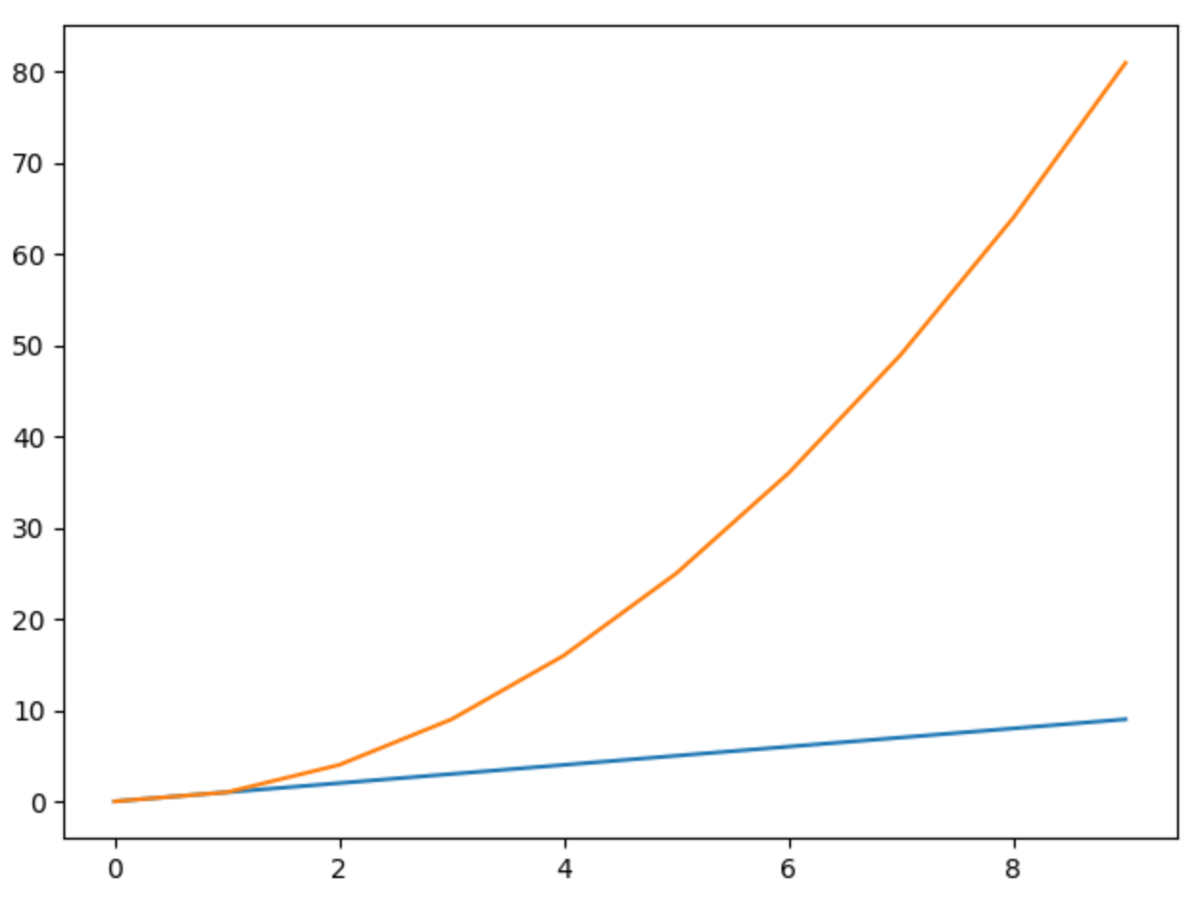

Target OUTPUT
Sub -Set of tests of constant size that maximizes the number of bugs.

Slide 5
Algorithm
For n number of tests to perform from N tests.
Calculate components entropy for all components.
Simulate running the test with fail and pass outcome.
Calculate test components new failure probabilities using SFL diagnoser.
Calculate components entropy after test simulation(for fail and pass outcome).
Choose the test with minimum entropy = maximum information gain given the previous tests already chosen.
Continue choose tests till reach n.

Slide 6
Algorithm - Test Entropy
Test Entropy = TestE1 + TestE2
Where :
TestE1 = success_probability(test) * success_entropy(test)
TestE2 = failure_probability(test) * failure_entropy(test)
Entropy calculated on all componenets.

Slide 7
Example
Comp# - represent component i
Test# - represent test j which pass through comp1….n
Prior Component Failure Probability
Comp1 | Comp2 | Comp3 | Comp4 | Comp5
0.25 | 0.12 | 0.44 | 0.7 | 0.03
Tests Trace
(1 - indicates that test pass through component)
 | Comp1 | Comp2 | Comp3 | Comp4 | Comp5
Test1 | 1 | 0 | 1 | 1 | 0
Test2 | 0 | 1 | 1 | 0 | 1
Test3 | 0 | 1 | 1 | 0 | 0
Test4 | 1 | 0 | 0 | 0 | 1
Test5 | 1 | 1 | 1 | 0 | 0

Slide 8
Test selection
Calculate components general entropy (priors)
For each test
Calculate test joint success probability
Calculate test success entropy
Calculate test joint failure probability
Calculate test
failure entropy
Test simulated entropy
Choose test with highest Information Gain
Run the chosen test and update its components new failure priors
Continue to the next test that maximizes the IG
Time

Slide 9
Test joint probability Calculation
Prior Component Failure Probability
Comp1 | Comp2 | Comp3 | Comp4 | Comp5
0.25 | 0.12 | 0.44 | 0.7 | 0.03
Tests Trace (1 - indicates that test pass through component)
 | Comp1 | Comp2 | Comp3 | Comp4 | Comp5 | Prior Failure Joint Probability | Prior Success Joint Probability
Test1 | 1 | 0 | 1 | 1 | 0 | (1 - (1- 0.25)*(1-0.44)*(1-0.7) ) | (1- 0.25)*(1-0.44)*(1-0.7)
Test2 | 0 | 1 | 1 | 0 | 1 | (1 - (1-0.12)*(1-0.44) *(1-0.03)) | (1-0.12)*(1-0.44) *(1-0.03)
Test3 | 0 | 1 | 1 | 0 | 0 | (1 - (1-0.12)*(1-0.44) ) | (1-0.12)*(1-0.44)
Test4 | 1 | 0 | 0 | 0 | 1 | (1 - (1-0.25)*(1-0.03) ) | (1-0.25)*(1-0.03)
Test5 | 1 | 1 | 1 | 0 | 0 | (1 - (1- 0.25)*(1-0.12)*(1-0.44) ) | (1- 0.25)*(1-0.12)*(1-0.44)

Slide 10
Test Entropy Calculation
Prior Component Failure Probability
Comp1 | Comp2 | Comp3 | Comp4 | Comp5
0.25 | 0.12 | 0.44 | 0.7 | 0.03
General Entropy (components success priors)
Entropy(0.75,0.88,0.56,0.3,0.97)
Simulation Test1 (Comp1,Comp3,Comp4)
Test pass - 1 | Test fail - 0
Entropy(0.74,0.12,0.79,0.52,0.03) | Entropy(0.18,0.12,0.23,0.08,0.03)
Test Entropy = TestE1 + TestE2
Where :
TestE1 = success_probability(test) * success_entropy(test)
TestE2 = failure_probability(test) * failure_entropy(test)
For each test:
Simulate running test with fail and pass outcome using SFL Diagnoser.
Get test components new failure probabilities from SFL Diagnoser and combine it with the rest of the components.
Choose the test with maximum information(minimum entropy) gain by:
argmax i(general entropy – test i entropy)

Slide 11
Choose Test
Test | General Entropy | Test Entropy | Information Gain
Test1 | 7.5 | 3.8 | 3.7
Test2 | 7.5 | 4.8 | 2.7
Test3 | 7.5 | 5.2 | 2.3
Test4 | 7.5 | 2.1 | 5.4
Test5 | 7.5 | 5.6 | 1.9
Max Information Gain
Test4 chosen by it’s highest information gain.
Test4 will actually run and get new components prior probabilities for failure.
The test entropy calculation will perform again without test4 and choose the next test with the highest information gain and repeat till the chosen test count reaches the a required number n.

Slide 12
Experiment Results
Compare test selection using information gain selection vs. top high failure probability tests.
n – number of tests
IG - Information gain selection
TFB - Top high failure probability tests
F – Failed P - Passed
 | IG |  | TFB
n | failed | passed | failed | passed
5 | 2 | 3 | 2 | 3
10 | 2 | 8 | 3 | 7
15 | 2 | 13 | 4 | 11
Test# | 1 | 2 | 3 | 4 | 5 | 6 | 7 | 8 | 9 | 10 | 11 | 12 | 13 | 14 | 15
IG | F | F | P | P | P | P | P | P | P | P | P | P | P | P | P
TFB | P | P | P | F | F | F | P | P | P | P | P | P | P | P | F

Slide 13
Experiment Results
Compare test selection using information gain selection vs. top high failure probability tests.
IG - Information gain selection
TFB - Top high failure probability tests

Slide 14
Open Issues & Future Work
SFL Diagnoser does not allow state fail in some cases (run test simulation required).
Need to implement failure probability calculation independently from SFL Diagnoser.
Compare IG test selection algorithm according in terms of component test covering.
Optimize the algorithm to find more failing tests.

Slide 15
Thanks!

